Slide 1
Decision Forest Regression
By Sehrish Fahim
Matriculation # 1277599

Slide 2
What is Machine learning & Decision Forest Regression
Machine Learning is an idea to learn from examples and experience, without being explicitly programmed. Instead of writing code, you feed data to the generic algorithm, and it builds logic based on the data given
Random forests or random decision forests are an ensemble learning method for classification, regression and other tasks that operates by constructing a multitude of decision trees at training time and outputting the class that is the mode of the classes (classification) or mean prediction (regression) of the individual trees.Random decision forests correct for decision trees' habit of overfitting to their training set

Slide 3
Regression:
Given predictor variables x, and a continuous response variable y, build a model for: – Predicting the value of y for a new value of x – Understanding the relationship between x and y
e.g. predict a person’s systolic blood pressure based on their age, height, weight, etc.

Slide 4
Algorithm Working:
By using learning API integrate decision forest algorithm
Use of 80% data to train the system
Use 20% data to test the prediction accuracy
Implemented two Split mode:
RSS - best for regression
GINI – best for classification

Slide 5
Code Explanation:
Taking randmom subsample from given data
Split the data by using RSS for regression model
Calling method recursively to build trees
Depending on number of trees in parameter it creats trees
While prediction happen by going through each tree
Some the result and take mean value as final result

Slide 6
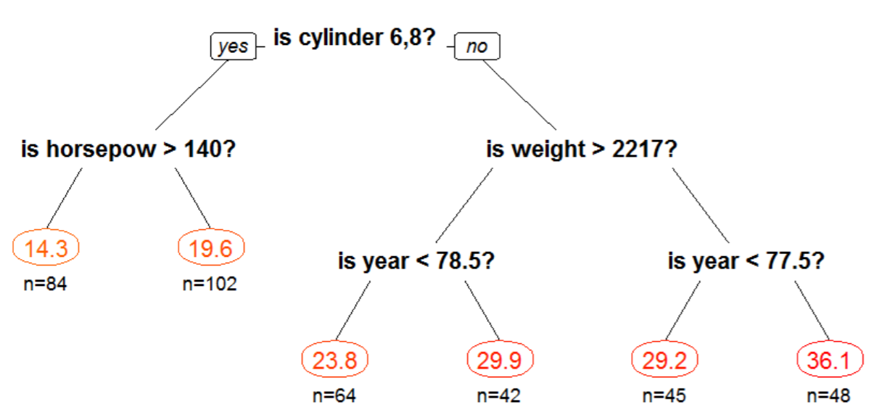
A Regression Tree

Slide 7
Random Forest
• Same idea for regression and classification YES!
• Handle categorical predictors naturally YES!
• Quick to fit, even for large problems YES!
• No formal distributional assumptions YES!
• Automatically fits highly non-linear interactions YES!
• Automatic variable selection YES! importance
• Handle missing values through proximities
• Very easy to interpret if the tree is small NO!
• The terminal nodes suggest a natural clustering NO!

Slide 8
Splitting Criteria:
Regression: residual sum of squares RSS = ∑left (yi – yL*)2 + ∑right (yi – yR*)2 where yL* = mean y-value for left node yR* = mean y-value for right node
• Classification: Gini criterion Gini = nL ∑k=1,…,K pkL (1- pkL) + nR ∑k=1,…,K pkR (1- pkR) where pkL = proportion of class k in left node pkR = proportion of class k in right node

Slide 9
CART: Advantages over traditional statistical methods
• No formal distributional assumptions
• Can automatically fit highly non-linear interactions
• Automatic variable selection
• Handle missing values through surrogate variables
• Very easy to interpret if the tree is small
• The terminal nodes suggest a natural clustering

Slide 10
CART: Advantages over other machine learning methods
• Same tool for regression and classification
• Handle categorical predictors naturally
• Quick to fit, even for large problems

